Slide 1
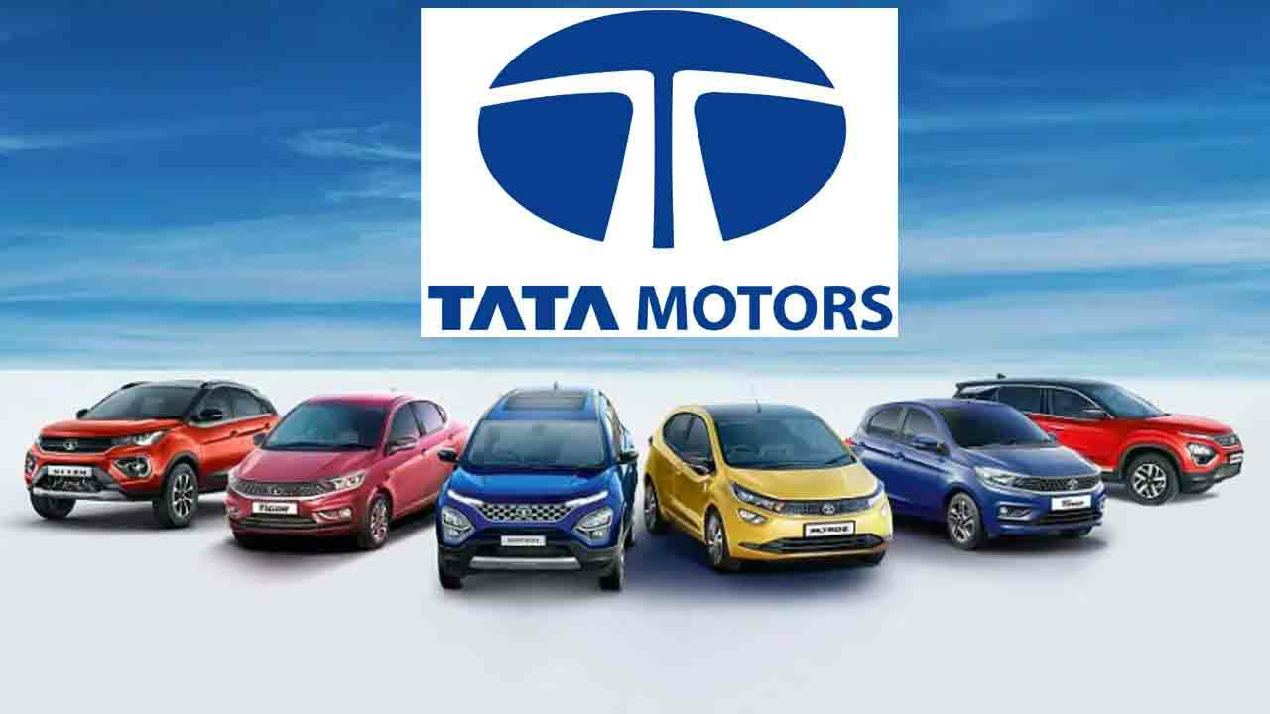

Slide 2
Presented By
Team leader 1: KANUGAMANU LAVANYA
Team Member 2: K.BABU
Team Member 3: K.N.BADRISH
Team Member 4: KAVYA SHREE .M
Team Member 5: KOPPALA HEKSHITHA REDDY
Team Member 6: M.TIRUMALESH

Slide 3
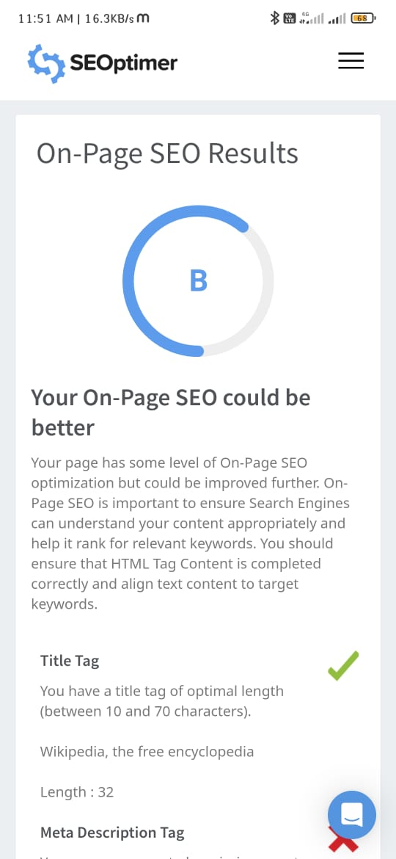
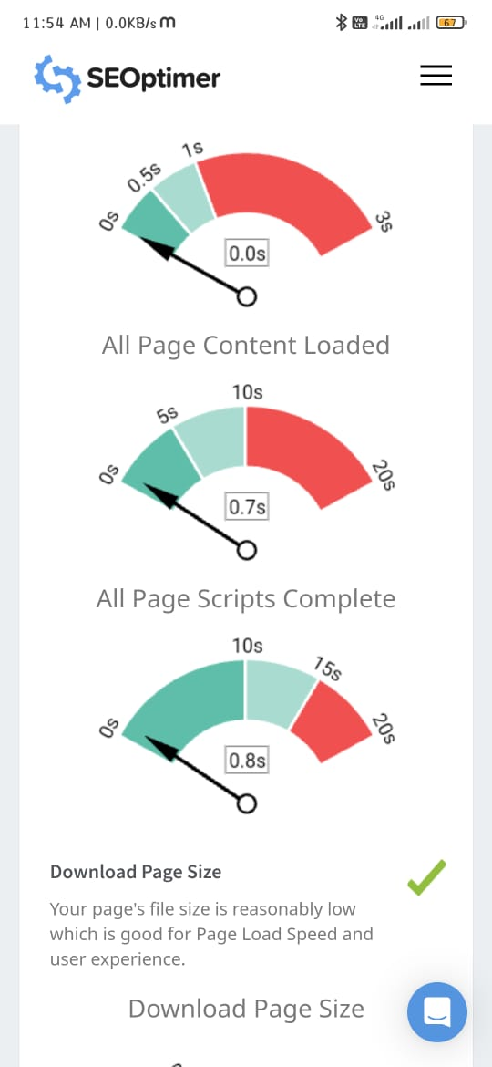
SEO OF THE TATA MOTORS

Slide 4
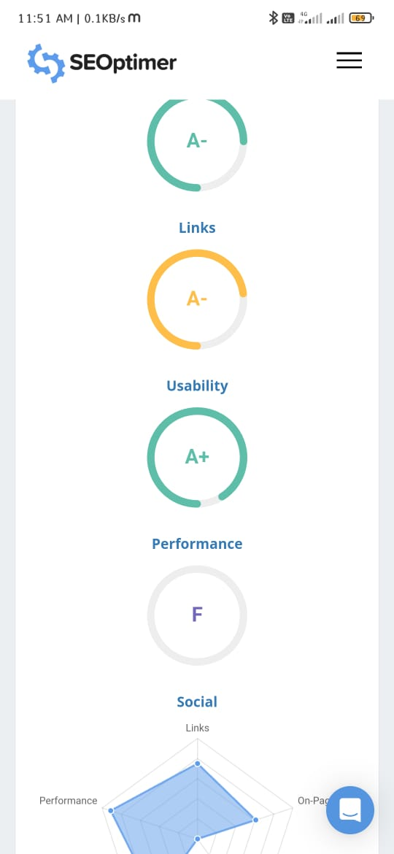
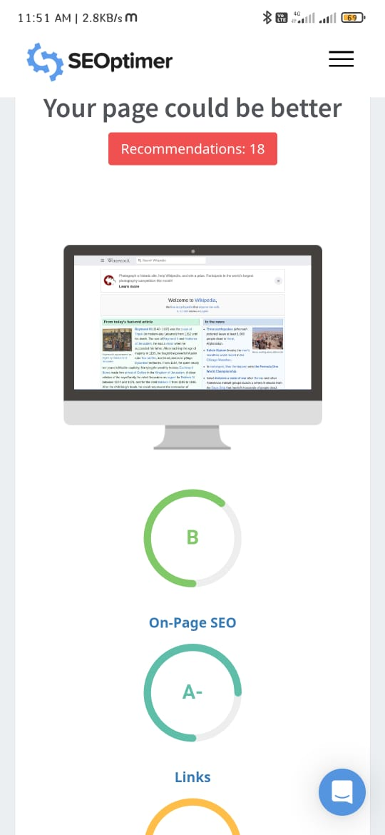
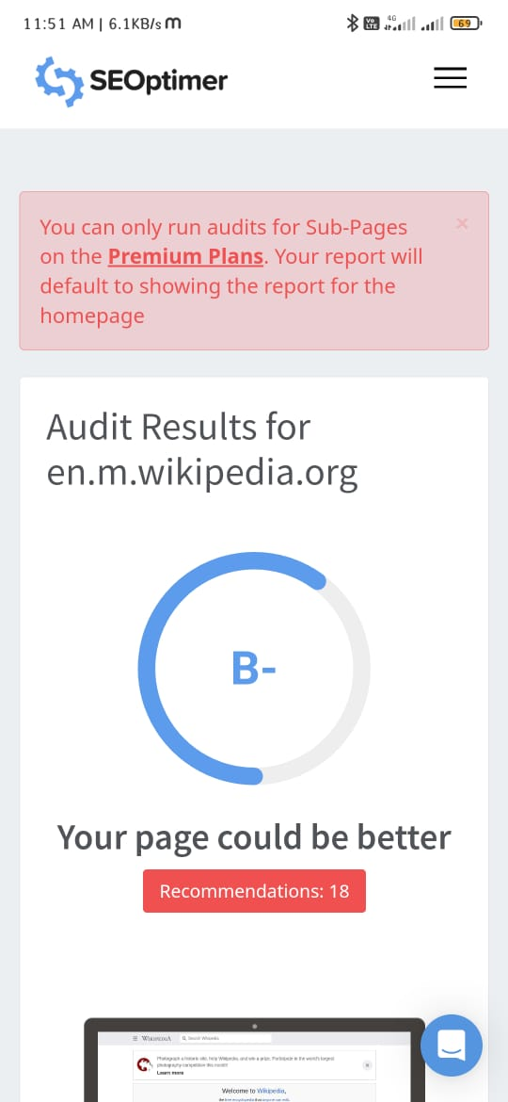

Slide 5


Driving Forward: An Insight into Tata Motors' Success and Future Innovations

Slide 6


Introduction
Tata Motors is a leading Indian automotive manufacturer that has been driving innovation and success in the industry for decades. This presentation will provide insights into Tata Motors' journey, achievements, and future
innovations.

Slide 7
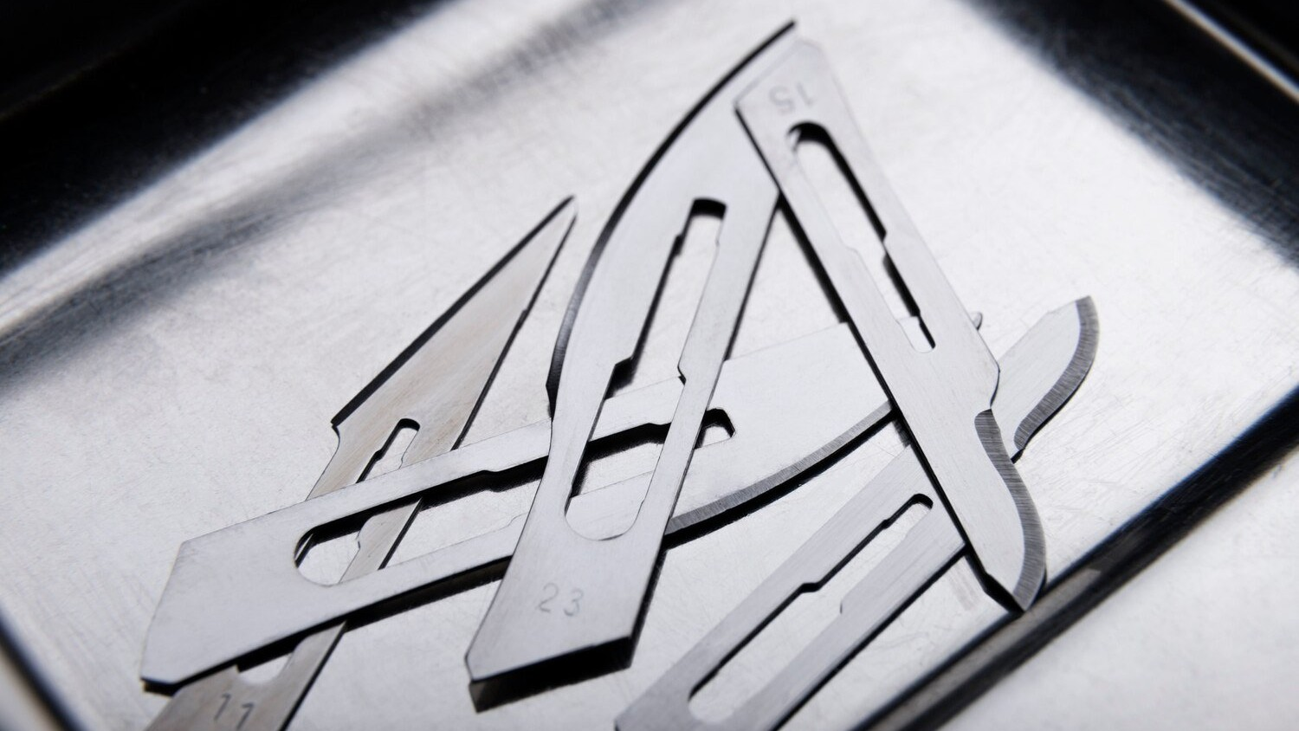

History
Founded in 1945, Tata Motors has grown to become one of the largest automobile manufacturers in India. The company has a rich history of innovation, including the development of India's ﬁrst fully indigenous passenger car, the Indica.

Slide 8

Global Presence
Tata Motors has a strong global presence, with operations in over 100 countries. The company has production facilities in India, the UK, South Korea, Thailand, and South Africa, among
others.

Slide 9




Product Portfolio
Tata Motors offers a diverse range of vehicles, including passenger cars, commercial vehicles, and electric vehicles. Some of the company's popular brands include the Tiago, Nexon, and Harrier.

Slide 10
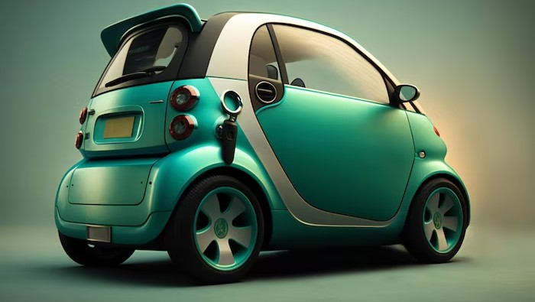
Sustainability
Tata Motors is committed to sustainability and has taken several initiatives to reduce its carbon footprint. The company has launched electric vehicles, implemented water conservation measures, and reduced
waste generation.

Slide 11
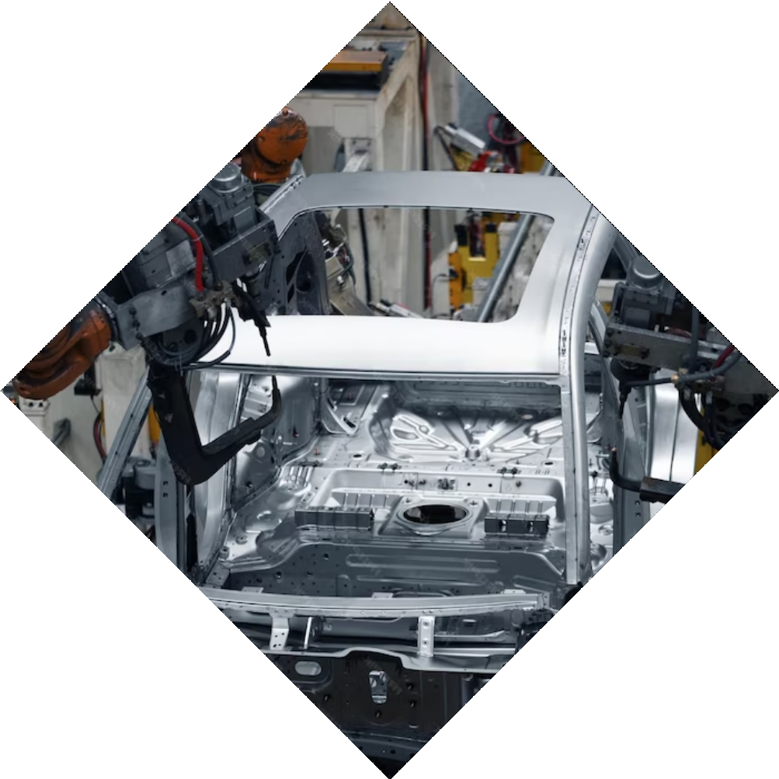


Innovation
Tata Motors has a strong focus on innovation and has ﬁled over 8,000 patents. The company has developed several groundbreaking technologies, including the Revotron engine and the Ziptron electric powertrain.

Slide 12


Awards and Recognition
Tata Motors has received several awards and recognitions for its products and services. The company has won the prestigious Golden Peacock Award for sustainability and the J.D. Power Award
for customer satisfaction.

Slide 13
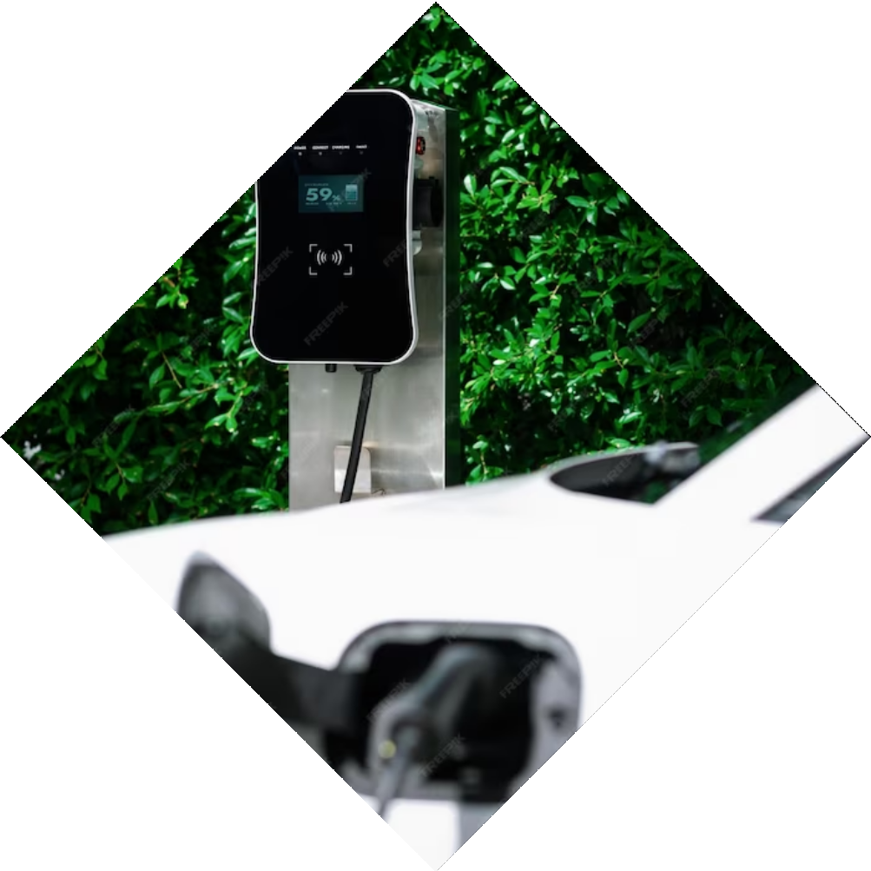
Future Innovations
Tata Motors is investing heavily in research and development to drive future innovations. The company is working on developing autonomous vehicles, connected cars, and alternative fuel
technologies.

Slide 14



Partnerships
Tata Motors has formed several strategic partnerships to enhance its capabilities and expand its reach. The company has partnered with Volkswagen to develop new vehicles and with Microsoft to integrate connected car technologies.

Slide 15

Financial Performance
Tata Motors has delivered strong ﬁnancial performance in recent years. The company reported a revenue of
$44.8 billion in 202 and a net proﬁt of
$1.2 billion.

Slide 16

Challenges
Tata Motors faces several challenges, including intense competition, changing consumer preferences, and regulatory changes. The company is working on addressing these challenges through innovation and strategic partnerships.

Slide 17
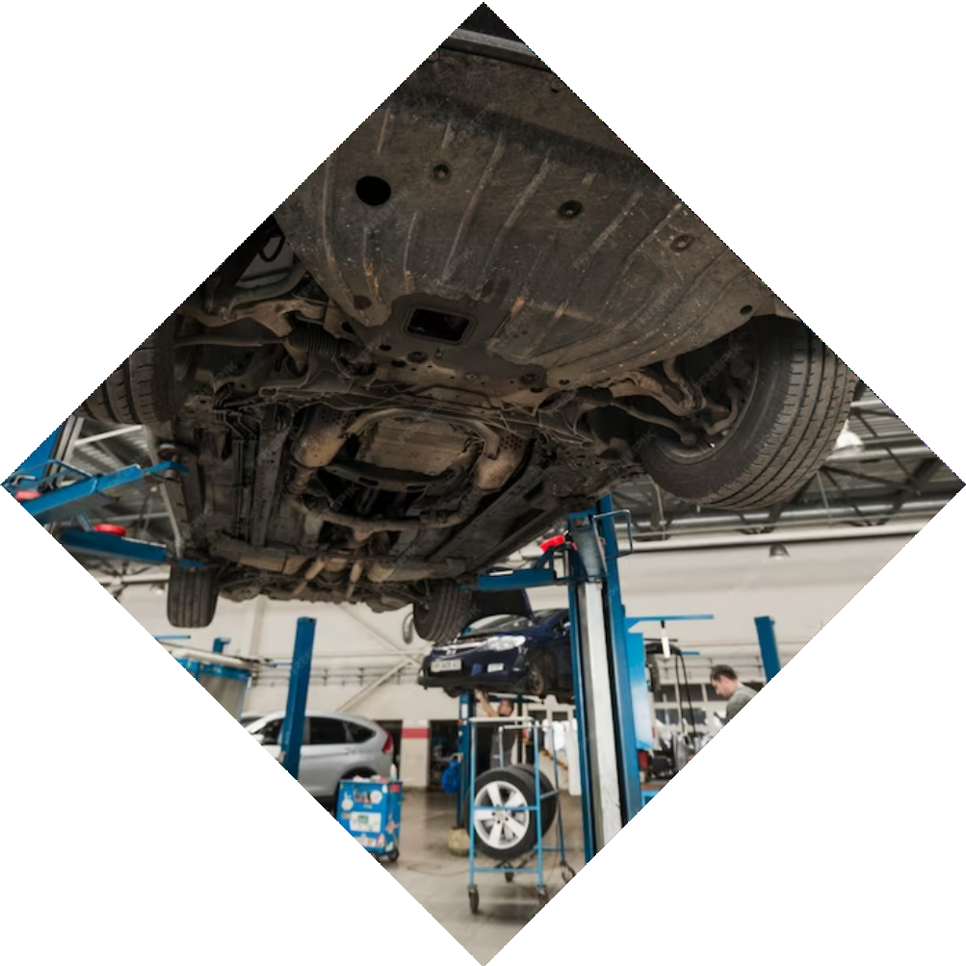
Customer Service
Tata Motors is committed to providing excellent customer service. The company has a strong network of dealerships and service centers across India and has implemented several initiatives to enhance the customer experience.

Slide 18


Employee Engagement
Tata Motors values its employees and has implemented several initiatives to engage and motivate them. The company has a strong focus on diversity and inclusion and has launched several programs to support employee development.

Slide 19

Corporate Social Responsibility
Tata Motors is committed to giving back to society and has implemented several corporate social responsibility initiatives. The company has launched programs to support education, healthcare, and community development.

Slide 20
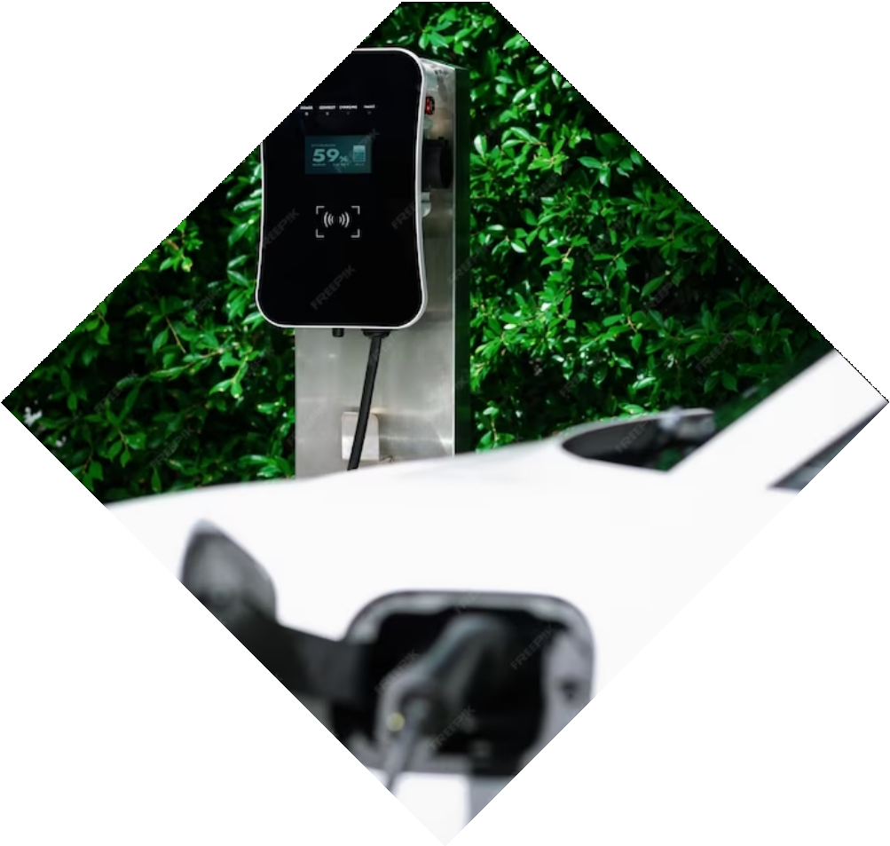
Future Outlook
Tata Motors has a bright future outlook, with a strong focus on innovation, sustainability, and customer service. The company is well-positioned to capitalize on the growing demand for electric vehicles and connected cars.

Slide 21
Conclusion
Tata Motors is a leading Indian automotive manufacturer that has achieved signiﬁcant success and growth through innovation, sustainability, and customer service. The company is well-positioned to drive future innovations and capitalize on emerging opportunities.

Slide 22
Thanks!
Do you have any questions?

